Slide 1
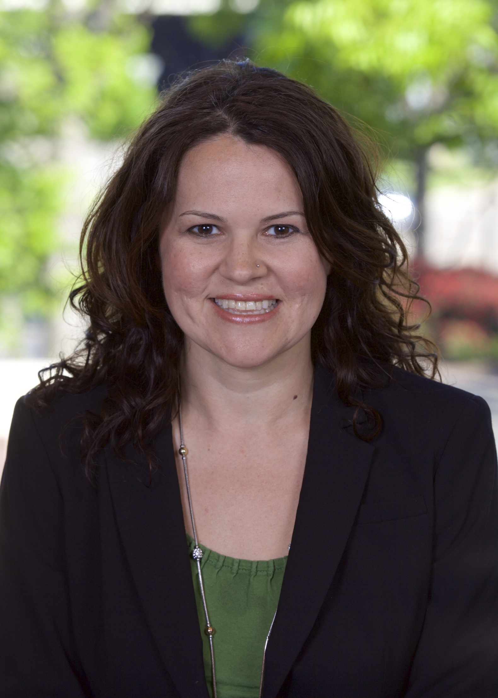
Suzanne Danforth
Americas Markets Lead, Oil, Refining & NGLs
Biography
Connect with Suzanne
Suzanne Danforth is the Americas Markets Lead for oil, refining & NGLs at Wood Mackenzie. She leads our global short-term global demand outlook and focuses on our North American short-term and long-term demand. She leads the refining analyst team and focuses on establishing how the North American refining industry fits in the global market and competitive landscape.
She has 20 years of experience in the energy information space, from developing methodologies and price assessments for global energy and metals commodities at Argus and S&P Platts to leading near-real-time product development for NGLs and refined products fundamental data at Genscape.
Prior to joining Wood Mackenzie, Suzanne managed the downstream oil team at Genscape, leading content creation and product development focused on providing transparency in oil fundamental data and markets.
She has a bachelor’s degree from Rice University in Political Science/Economics and a masters’ degree from Penn State for Data Analytics.
suzanne.danforth@woodmac.com
+1 281 243 8325

